Slide 1
Colourful Semantics
Merstone School
June 2013
by Gillian Clowe
IDEAS
Play as a group game on IWB
Use during a reading session
Bingo game
Extend by asking Where?

Slide 2
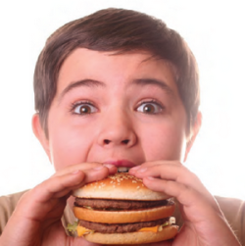
Match words to the colour box to make a sentence
What doing
Who
What
The boy is eating a burger

Slide 3
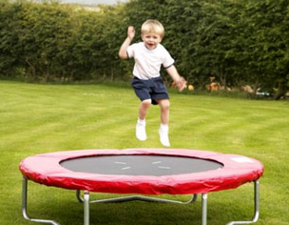
boy
jumping
trampoline
The boy is jumping on the trampoline

Slide 4
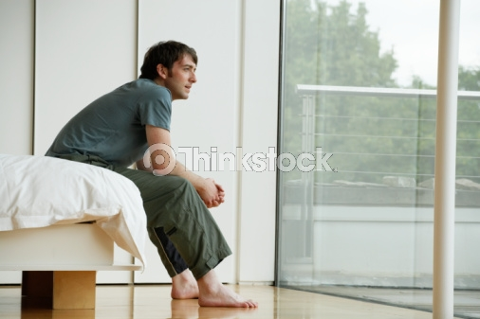
man
sitting
bed
The man is sitting on the bed.

Slide 5
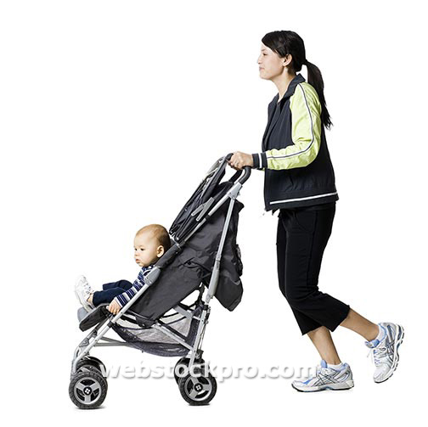
Lady
pushing
buggy
The lady is pushing the buggy.

Slide 6
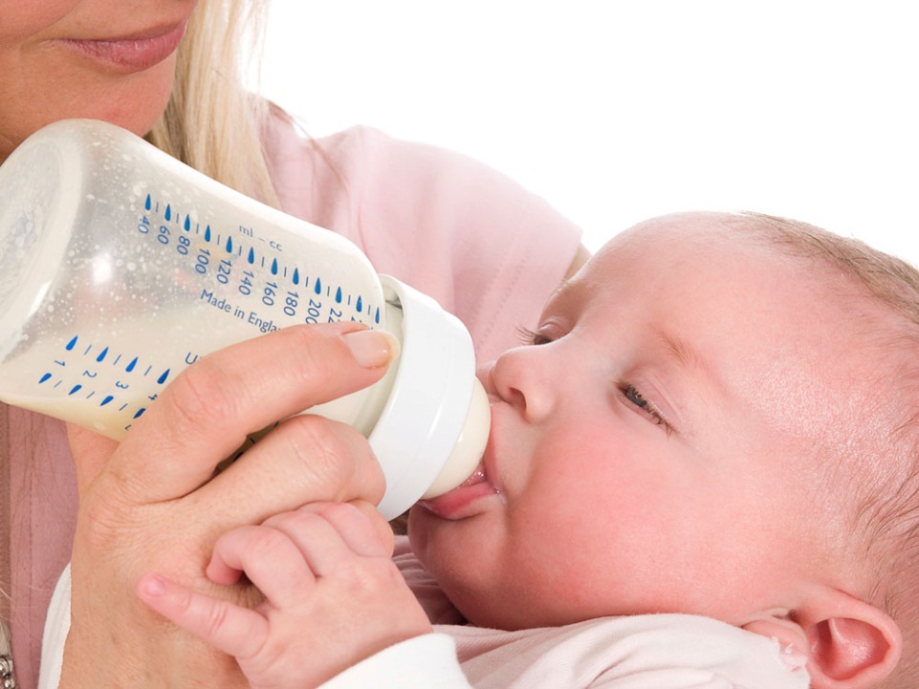
baby
drinking
milk
The baby is drinking milk.

Slide 7
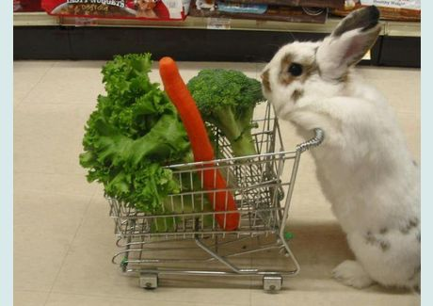
Rabbit
pushing
trolley
The rabbit is pushing the trolley.

Slide 8
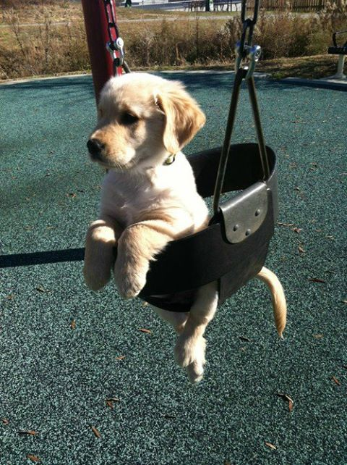
Dog
sitting
swing
The dog is sitting in the swing.

Slide 9
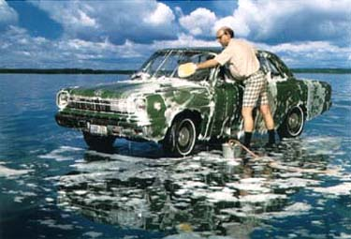
Man
washing
car
The man is washing the car.

Slide 10
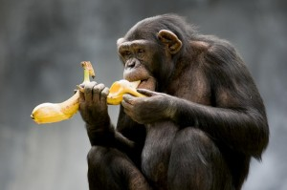
Monkey
eating
banana
The monkey is eating a banana.

Slide 11
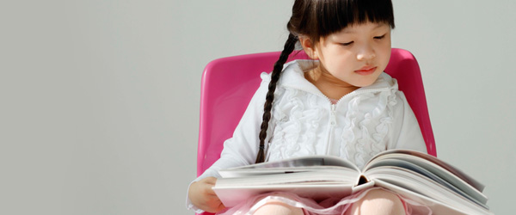
Girl
reading
book
The girl is reading a book.

Slide 12
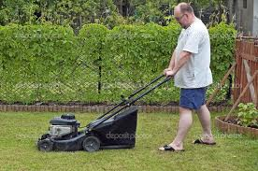
Man
cutting
grass
The man is cutting the grass.

Slide 13
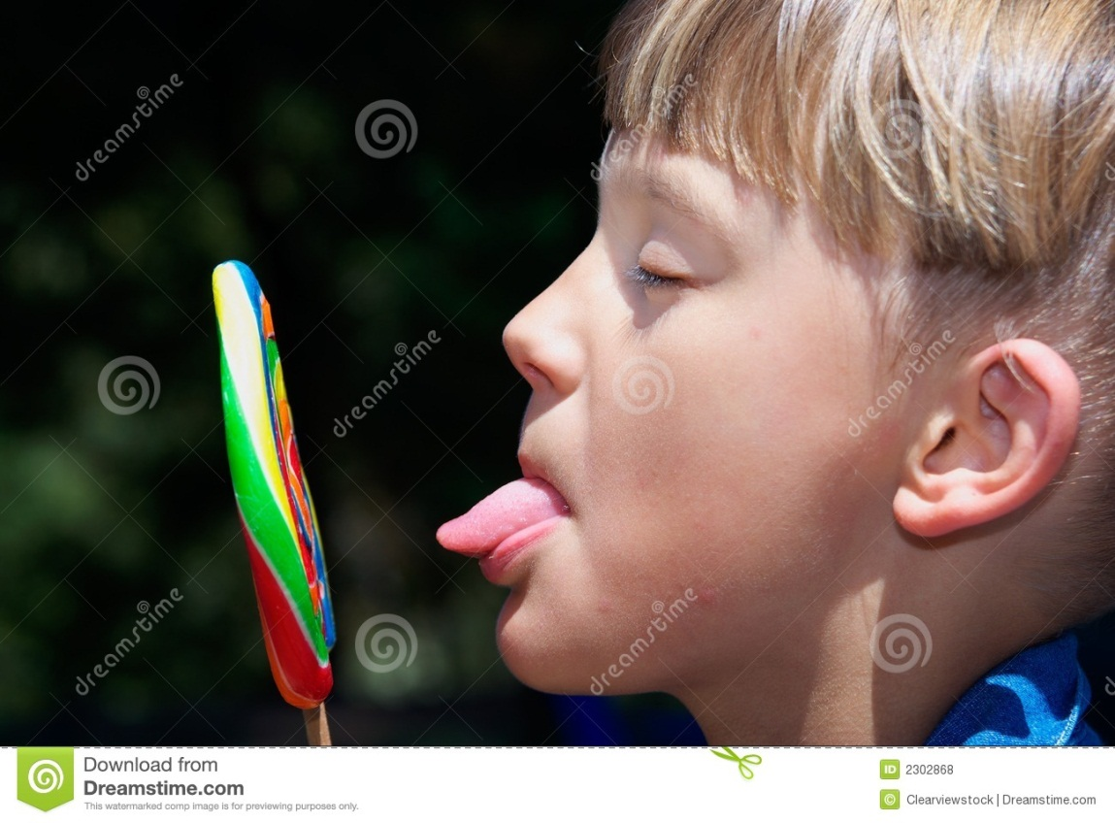
Boy
licking
lolly
The boy is licking a lolly.

Slide 14
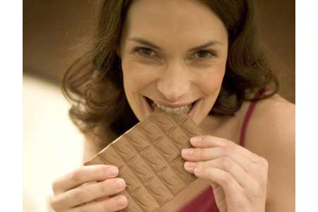
Lady
eating
chocolate
The lady is eating chocolate.

Slide 15
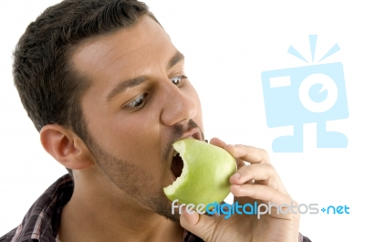
Man
eat
apple
The man is eating an apple.

Slide 16
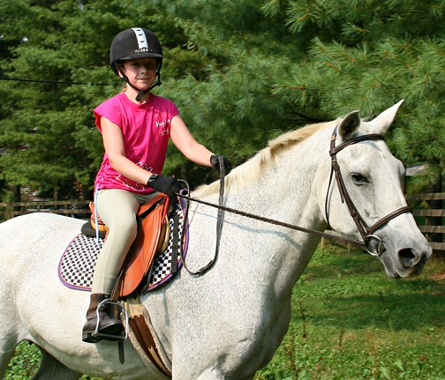
Girl
ridding
horse
The girl is ridding a horse.

Slide 17
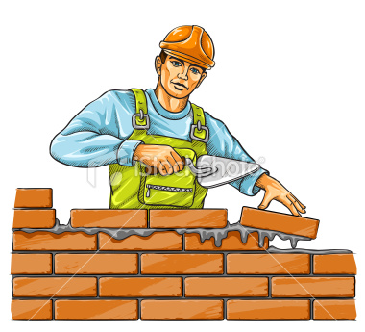
Man
building
wall
The man is building a wall.

Slide 18
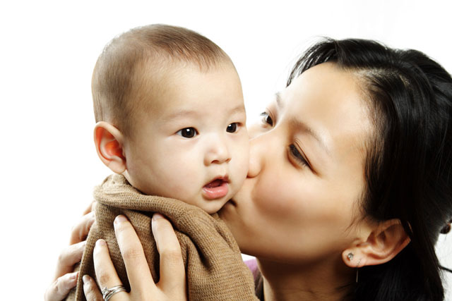
Lady
kiss
baby
The lady is kissing the baby.

Slide 19
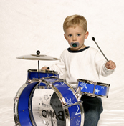
Boy
play
drums
The boy is playing the drums.

Slide 20
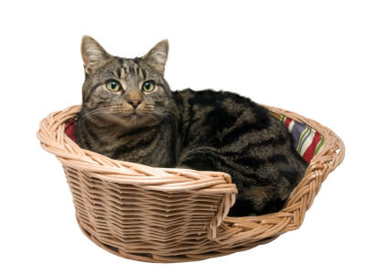
Cat
sit
basket
The cat is sitting in the basket.

Slide 21
Template
Add your own images
what doing
who
what
Add your own sentence and change colours.

Slide 22
Draw a picture and add the sentence using ‘who’ ‘what doing’ and ‘what’

